Slide 1
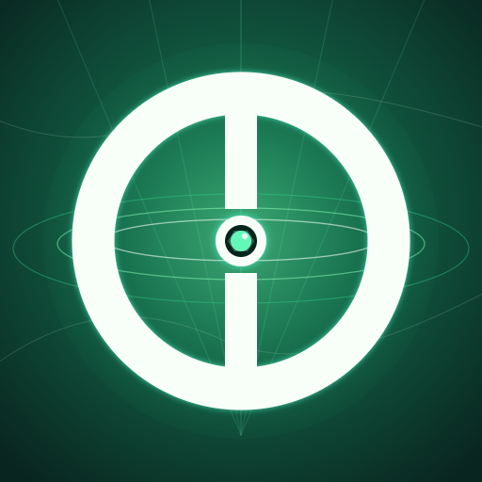
Whitepaper deck / 2026
SpaceOnne
ONNE
A cartographic RWA ecosystem where useful action becomes a digital asset
From Satoshi to TON
Web3 energy of the future is in your hands
SpaceOnne
01

Slide 2
Product thesis
Problem and opportunity
Data is created by people
Mining should be useful
ONNE is connected to an asset
Routes, points, and spatial content are created in the real world, but their value is usually captured by centralized platforms.
SpaceOnne replaces abstract activity with useful work: 360 and 3D capture of digital space.
The token is linked to verified digital space, not only to an interface mechanic.
SpaceOnne turns everyday movement into verified cartographic content that becomes part of the shared digital space.
SpaceOnne
02

Slide 3
Architecture
One ecosystem, multiple product layers
SpaceOnne
Brand and unified product
Core logic
Atlas
360 / 3D, GPS, AI agents, miner validation
Content -> review -> storage -> ONNE release -> user reward + validator commission
Protocol 101
Staking, miners, reward logic
Wallet
ONNE, TON, USDT, deposits, withdrawals, exchange
Community
Chats, groups, achievements
SpaceOnne
03

Slide 4
Atlas
How value is created
360 / 3D
GPS proof
AI agents
Miners
DB / Map
ONNE
A user completes a task, AI agents review it first, miner owners validate the result, accepted content is stored in the database and map, and the blockchain distributes ONNE.
SpaceOnne
04

Slide 5
User motivation
Earning while moving
360: the user reaches a point and creates content
Real World Activity
3D: the user follows a route and collects multiple points
Action in the real world creates a digital asset
A delivery worker, courier, or rider can earn not only at the delivery point but also along the way
Content becomes part of the shared digital space
SpaceOnne
05

Slide 6
Protocol 101
Miners: staking and validation
Staking utility
Validation role
Commission
A miner unlocks staking logic and reward mechanics based on its product level.
In Atlas, miner owners validate content after the AI stage.
For an approval, miner owners receive a commission from ONNE distribution.
A miner is not a decorative card. It is a SpaceOnne digital product with a practical role in staking and cartographic-content validation.
ONNE spent on miners may be burned. Staking removes ONNE from free circulation for the duration of a position.
SpaceOnne
06

Slide 7
App surface
Wallet, assets, and community
Assets
Operations
Zero-fee zone
ONNE, TON, USDT, and other supported assets.
Deposits, withdrawals, exchange through decentralized tools, and staking.
Internal transfers have no SpaceOnne fee unless the feature rules state otherwise.
Community
Unified account
Chats, groups, achievements, and activity sharing.
One user environment for content, assets, and the social layer.
SpaceOnne
07

Slide 8
ONNE tokenomics
Supply and initial allocation
Total supply
Team and early conversion stay locked at launch under vesting and liquidity gates.
1 010 000 000 ONNE
Atlas / staking / rewards / ecosystem
29.703%
Liquidity + market making
23.762%
Listings / partners / operations
15.842%
Treasury / reserve
12.871%
Team locked vesting
9.901%
Pre-DEX Point conversion
7.921%
SpaceOnne
08

Slide 9
Market protection
Unlocks without sudden market pressure
Start reference
Locked conversion
Liquidity gates
0.001 USDT / ONNE
2 000 TON + 3 180 000 ONNE
Legacy ONNE Point conversion is not released freely as a single block.
Claim windows depend on pool depth and market conditions.
Dry-run coefficient
215.551052515 Point = 1 ONNE
Miner/staking cohort with rewards: about 3.028M ONNE in dry-run model
SpaceOnne
09

Slide 10
Roadmap
Product roadmap
01
02
03
04
05
Free distribution
Protocol 101 + ONNE on TON
Staking
Atlas / RWA
Native surfaces
Completed
Active layer
Active product layer
Expansion layer
Web / Telegram / iOS / Android
SpaceOnne
10

Slide 11
Closing
Useful action becomes a digital asset
SpaceOnne builds a loop in which a user creates digital space, AI agents and miners confirm quality, and ONNE is distributed between the creator and validators.
Official ONNE token on TON
EQAhDhLYceb_BrItaTPK7U6Y4xLnEXsQO9iOILEz37CIcwFe
These materials describe product mechanics and do not constitute financial, investment, tax, or legal advice.
SpaceOnne
11

